Slide 1
Comparison Sorts
Chapter 9.4, 12.1, 12.2

Slide 2
Sorting
We have seen the advantage of sorted data representations for a number of applications
Sparse vectors
Maps
Dictionaries
Here we consider the problem of how to efficiently transform an unsorted representation into a sorted representation.
We will focus on sorted array representations.

Slide 3
Outline
Definitions
Comparison Sorting Algorithms
Selection Sort
Bubble Sort
Insertion Sort
Merge Sort
Heap Sort
Quick Sort
Lower Bound on Comparison Sorts

Slide 4
Outline
Definitions
Comparison Sorting Algorithms
Selection Sort
Bubble Sort
Insertion Sort
Merge Sort
Heap Sort
Quick Sort
Lower Bound on Comparison Sorts

Slide 5
Comparison Sorts
Comparison Sort algorithms sort the input by successive comparison of pairs of input elements.
Comparison Sort algorithms are very general: they make no assumptions about the values of the input elements.
4 | 3 | 7 | 11 | 2 | 2 | 1 | 3 | 5

Slide 6
Sorting Algorithms and Memory
Some algorithms sort by swapping elements within the input array
Such algorithms are said to sort in place, and require only O(1) additional memory.
Other algorithms require allocation of an output array into which values are copied.
These algorithms do not sort in place, and require O(n) additional memory.
4 | 3 | 7 | 11 | 2 | 2 | 1 | 3 | 5
swap

Slide 7
Stable Sort
A sorting algorithm is said to be stable if the ordering of identical keys in the input is preserved in the output.
The stable sort property is important, for example, when entries with identical keys are already ordered by another criterion.
(Remember that stored with each key is a record containing some useful information.)
4 | 3 | 7 | 11 | 2 | 2 | 1 | 3 | 5
1 | 2 | 2 | 3 | 3 | 4 | 5 | 7 | 11

Slide 8
Outline
Definitions
Comparison Sorting Algorithms
Selection Sort
Bubble Sort
Insertion Sort
Merge Sort
Heap Sort
Quick Sort
Lower Bound on Comparison Sorts

Slide 9
Outline
Definitions
Comparison Sorting Algorithms
Selection Sort
Bubble Sort
Insertion Sort
Merge Sort
Heap Sort
Quick Sort
Lower Bound on Comparison Sorts

Slide 10
Selection Sort
Selection Sort operates by first finding the smallest element in the input list, and moving it to the output list.
It then finds the next smallest value and does the same.
It continues in this way until all the input elements have been selected and placed in the output list in the correct order.
Note that every selection requires a search through the input list.
Thus the algorithm has a nested loop structure
Selection Sort Example

Slide 11
Selection Sort
for i = 0 to n-1
A[0…i-1] contains the i smallest keys in sorted order.
A[i…n-1] contains the remaining keys
j_{min} = i
for j = i+1 to n-1
if A[ j ] < A[j_{min}]
j_{min} = j
swap A[i] with A[j_{min}]
LI:
Running time?

Slide 12
Outline
Definitions
Comparison Sorting Algorithms
Selection Sort
Bubble Sort
Insertion Sort
Merge Sort
Heap Sort
Quick Sort
Lower Bound on Comparison Sorts

Slide 13
Bubble Sort
Bubble Sort operates by successively comparing adjacent elements, swapping them if they are out of order.
At the end of the first pass, the largest element is in the correct position.
A total of n passes are required to sort the entire array.
Thus bubble sort also has a nested loop structure
Bubble Sort Example

Slide 14
Expert Opinion on Bubble Sort

Slide 15
Bubble Sort
for i = n-1 downto 1
A[i+1…n-1] contains the n-i-1 largest keys in sorted order.
A[0…i] contains the remaining keys
for j = 0 to i-1
if A[ j ] > A[ j + 1 ]
swap A[ j ] and A[ j + 1 ]
LI:
Running time?

Slide 16
Comparison
Thus both Selection Sort and Bubble Sort have O(n²) running time.
However, both can also easily be designed to
Sort in place
Stable sort

Slide 17
Outline
Definitions
Comparison Sorting Algorithms
Selection Sort
Bubble Sort
Insertion Sort
Merge Sort
Heap Sort
Quick Sort
Lower Bound on Comparison Sorts

Slide 18
Insertion Sort
Like Selection Sort, Insertion Sort maintains two sublists:
A left sublist containing sorted keys
A right sublist containing the remaining unsorted keys
Unlike Selection Sort, the keys in the left sublist are not the smallest keys in the input list, but the first keys in the input list.
On each iteration, the next key in the right sublist is considered, and inserted at the correct location in the left sublist.
This continues until the right sublist is empty.
Note that for each insertion, some elements in the left sublist will in general need to be shifted right.
Thus the algorithm has a nested loop structure
Insertion Sort Example

Slide 19
Insertion Sort
for i = 1 to n-1
A[0…i-1] contains the first i keys of the input in sorted order.
A[i…n-1] contains the remaining keys
key = A[i]
j = i
while j > 0 & A[j-1] > key
A[j] ← A[j-1]
j = j-1
A[j] = key
LI:
Running time?

Slide 20
Outline
Definitions
Comparison Sorting Algorithms
Selection Sort
Bubble Sort
Insertion Sort
Merge Sort
Heap Sort
Quick Sort
Lower Bound on Comparison Sorts

Slide 21
Divide-and-Conquer
Divide-and conquer is a general algorithm design paradigm:
Divide: divide the input data S in two disjoint subsets S₁ and S₂
Recur: solve the subproblems associated with S₁ and S₂
Conquer: combine the solutions for S₁ and S₂ into a solution for S
The base case for the recursion is a subproblem of size 0 or 1

Slide 22
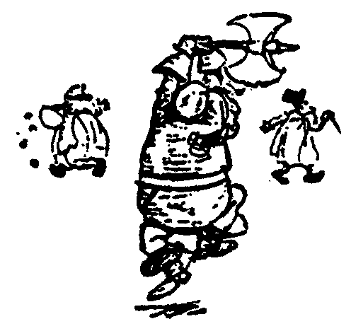
Recursive Sorts
Given list of objects to be sorted
Split the list into two sublists.
Recursively have two friends sort the two sublists.
Combine the two sorted sublists into one entirely sorted list.

Slide 23
Merge Sort
88
52
14
31
98
25
30
62
23
79
Divide and Conquer

Slide 24
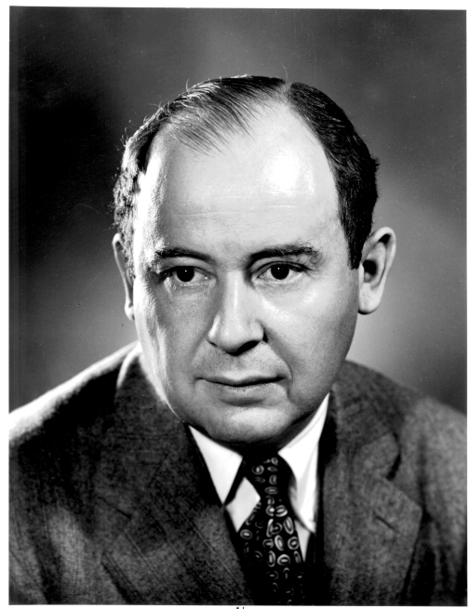
Merge Sort
Merge-sort is a sorting algorithm based on the divide-and-conquer paradigm
It was invented by John von Neumann, one of the pioneers of computing, in 1945

Slide 25
Merge Sort
88
52
Split Set into Two
14
31
98
(no real work)
25
30
62
23
79
Get one friend to sort the first half.
Get one friend to sort the second half.
25,31,52,88,98
14,23,30,62,79

Slide 26
Merge Sort
Merge two sorted lists into one
25,31,52,88,98
14,23,25,30,31,52,62,79,88,98
14,23,30,62,79

Slide 27
Merge-Sort
Merge-sort on an input sequence S with n elements consists of three steps:
Divide: partition S into two sequences S₁ and S₂ of about n/2 elements each
Recur: recursively sort S₁ and S₂
Conquer: merge S₁ and S₂ into a unique sorted sequence
Algorithm mergeSort(S)
Input sequence S with n elements
Output sequence S sorted
if S.size() > 1
(S₁, S₂) ⎜ split(S, n/2)
mergeSort(S₁)
mergeSort(S₂)
merge(S₁, S_{2,} S)

Slide 28
Merge Sort Example

Slide 29
Merging Two Sorted Sequences
The conquer step of merge-sort consists of merging two sorted sequences A and B into a sorted sequence S containing the union of the elements of A and B
Merging two sorted sequences, each with n/2 elements takes O(n) time
Straightforward to make the sort stable.
Normally, merging is not in-place: new memory must be allocated to hold S.
It is possible to do in-place merging using linked lists.
Code is more complicated
Only changes memory usage by a constant factor

Slide 30
Merging Two Sorted Sequences (As Arrays)

Slide 31
Merging Two Sorted Sequences (As Linked Lists)

Slide 32
Merge-Sort Tree
An execution of merge-sort is depicted by a binary tree
each node represents a recursive call of merge-sort and stores
unsorted sequence before the execution and its partition
sorted sequence at the end of the execution
the root is the initial call
the leaves are calls on subsequences of size 0 or 1
7 2 | 9 4 => 2 4 7 9
7 | 2 => 2 7
9 | 4 => 4 9
7 => 7
2 => 2
9 => 9
4 => 4

Slide 33
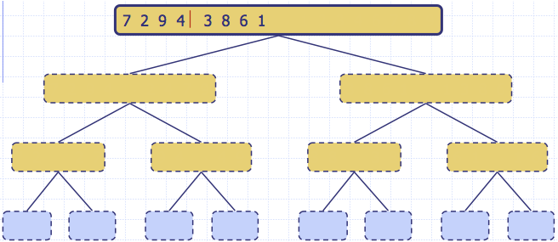
Execution Example
Partition

Slide 34
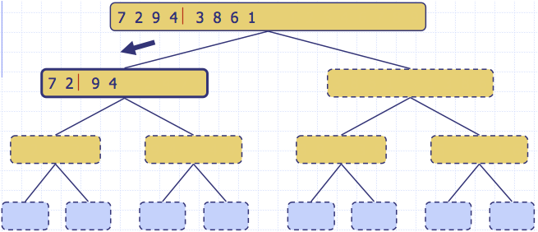
Execution Example (cont.)
Recursive call, partition

Slide 35
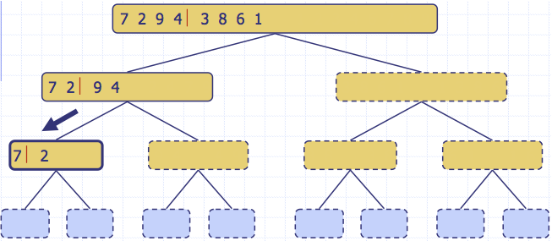
Execution Example (cont.)
Recursive call, partition

Slide 36
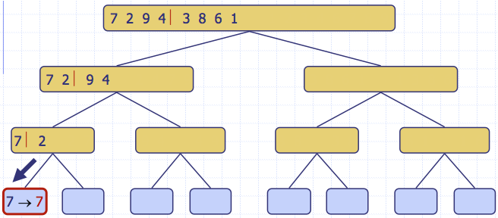
Execution Example (cont.)
Recursive call, base case

Slide 37
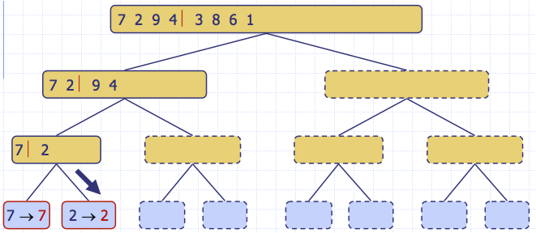
Execution Example (cont.)
Recursive call, base case

Slide 38
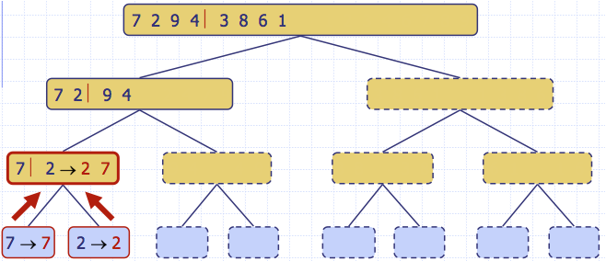
Execution Example (cont.)
Merge

Slide 39
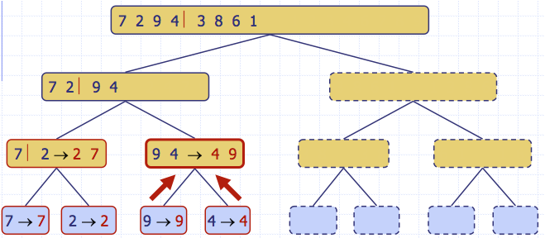
Execution Example (cont.)
Recursive call, …, base case, merge

Slide 40
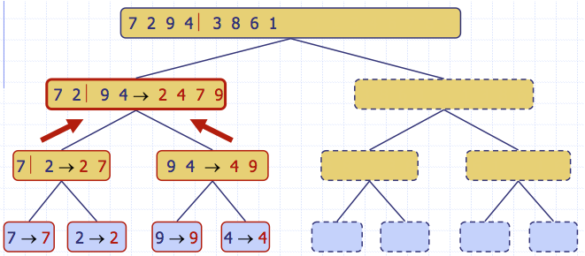
Execution Example (cont.)
Merge

Slide 41
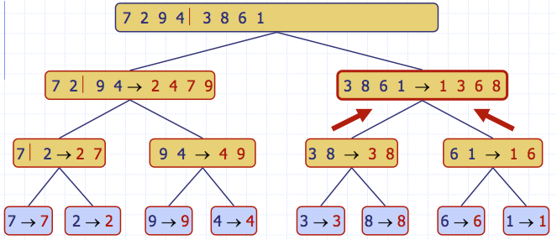
Execution Example (cont.)
Recursive call, …, merge, merge

Slide 42
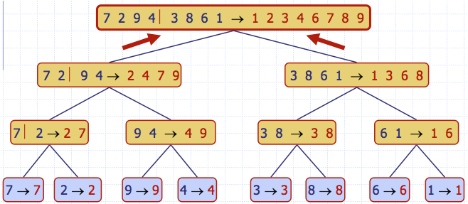
Execution Example (cont.)
Merge

Slide 43
Analysis of Merge-Sort
The height h of the merge-sort tree is O(log n)
at each recursive call we divide the sequence in half.
The overall amount or work done at the nodes of depth i is O(n)
we partition and merge 2^{i} sequences of size n/2^{i}
Thus, the total running time of merge-sort is O(n log n)!
depth | #seqs | size
0 | 1 | n
1 | 2 | n/2
i | 2^{i} | n/2^{i}
… | … | …

Slide 44
Running Time of Comparison Sorts
Thus MergeSort is much more efficient than SelectionSort, BubbleSort and InsertionSort. Why?
You might think that to sort n keys, each key would have to at some point be compared to every other key:
However, this is not the case.
Transitivity: If A < B and B < C, then you know that A < C, even though you have never directly compared A and C.
MergeSort takes advantage of this transitivity property in the merge stage.

Slide 45
Outline
Definitions
Comparison Sorting Algorithms
Selection Sort
Bubble Sort
Insertion Sort
Merge Sort
Heap Sort
Quick Sort
Lower Bound on Comparison Sorts

Slide 46
Heapsort
Invented by Williams & Floyd in 1964
O(nlogn) worst case – like merge sort
Sorts in place – like selection sort
Combines the best of both algorithms

Slide 47
Selection Sort
Largest i values are sorted on the right.
Remaining values are off to the left.
3
5
<
1
6,7,8,9
4
2
Max is easier to find if the unsorted subarray is a heap.

Slide 48
Heap-Sort Algorithm
Build an array-based (max) heap
Iteratively call removeMax() to extract the keys in descending order
Store the keys as they are extracted in the unused tail portion of the array
Thus HeapSort is in-place!
But is it stable?
No – heap operations may disorder ties

Slide 49
Heapsort is Not Stable
Example (MaxHeap)
3
insert(2)
3
upheap
3
1
2
1
2
2
2
2
1
2nd
1st
3
insert(2)
3
2
2
2
1st
2nd

Slide 50
Heap-Sort Algorithm
Algorithm HeapSort(S)
Input: S, an unsorted array of comparable elements
Output: S, a sorted array of comparable elements
T = MakeMaxHeap (S)
for i = n-1 downto 0
S[i] = T.removeMax()

Slide 51
Heap Sort Example
(Using Min Heap)

Slide 52
Heap-Sort Running Time
The heap can be built bottom-up in O(n) time
Extraction of the ith element takes O(log(n - i+1)) time (for downheaping)
Thus total run time is

Slide 53
Heap-Sort Running Time
It turns out that HeapSort is also Ω(nlogn). Why?
Thus HeapSort is θ(nlogn).

Slide 54
Outline
Definitions
Comparison Sorting Algorithms
Selection Sort
Bubble Sort
Insertion Sort
Merge Sort
Heap Sort
Quick Sort
Lower Bound on Comparison Sorts

Slide 55
QuickSort
Invented by C.A.R. Hoare in 1960
“There are two ways of constructing a software design: One way is to make it so simple that there are obviously no deficiencies, and the other way is to make it so complicated that there are no obvious deficiencies. The first method is far more difficult.”

Slide 56
Quick-Sort
Quick-sort is a divide-and-conquer algorithm:
Divide: pick a random element x (called a pivot) and partition S into
L elements less than x
E elements equal to x
G elements greater than x
Recur: Quick-sort L and G
Conquer: join L, E and G
x
x
L
G
E
x

Slide 57
The Quick-Sort Algorithm
Algorithm QuickSort(S)
if S.size() > 1
(L, E, G) = Partition(S)
QuickSort(L) //Small elements are sorted
QuickSort(G) //Large elements are sorted
S = (L, E, G) //Thus input is sorted

Slide 58
Partition
Remove, in turn, each element y from S and
Insert y into list L, E or G, depending on the result of the comparison with the pivot x (e.g., last element in S)
Each insertion and removal is at the beginning or at the end of a list, and hence takes O(1) time
Thus, partitioning takes O(n) time
Algorithm Partition(S)
Input list S
Output sublists L, E, G of the elements of S less than, equal to, or greater than the pivot, resp.
L, E, G := empty lists
x := S.getLast().element
while S.isEmpty()
y := S.removeFirst(S)
if y < x
L.addLast(y)
else if y = x
E.addLast(y)
else { y > x }
G.addLast(y)
return L, E, G

Slide 59
Partition
Since elements are removed at the beginning and added at the end, this partition algorithm is stable.
Algorithm Partition(S)
Input sequence S
Output subsequences L, E, G of the elements of S less than, equal to, or greater than the pivot, resp.
L, E, G ⎜ empty sequences
x ⎜ S.getLast().element
while S.isEmpty()
y ⎜ S.removeFirst(S)
if y < x
L.addLast(y)
else if y = x
E.addLast(y)
else { y > x }
G.addLast(y)
return L, E, G

Slide 60
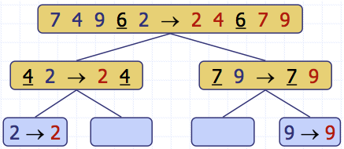
Quick-Sort Tree
An execution of quick-sort is depicted by a binary tree
Each node represents a recursive call of quick-sort and stores
Unsorted sequence before the execution and its pivot
Sorted sequence at the end of the execution
The root is the initial call
The leaves are calls on subsequences of size 0 or 1

Slide 61
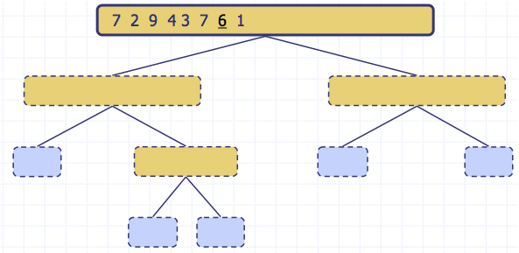
Execution Example
Pivot selection

Slide 62
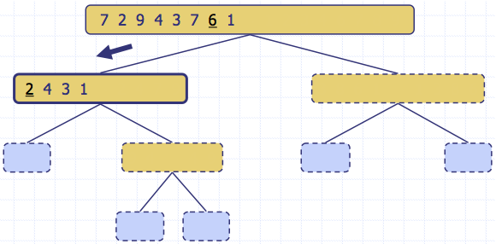
Execution Example (cont.)
Partition, recursive call, pivot selection

Slide 63
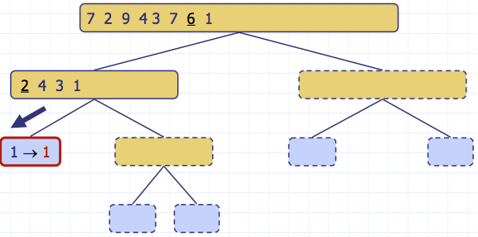
Execution Example (cont.)
Partition, recursive call, base case

Slide 64
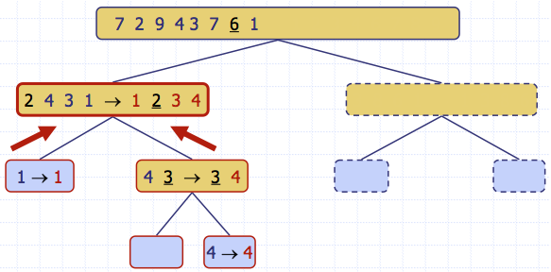
Execution Example (cont.)
Recursive call, …, base case, join

Slide 65
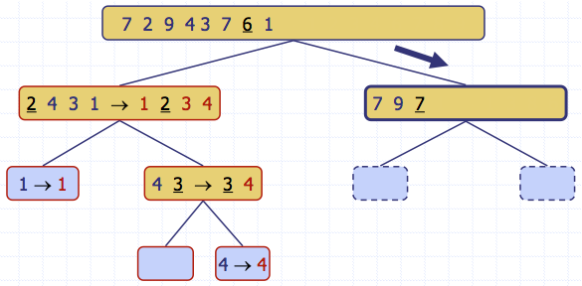
Execution Example (cont.)
Recursive call, pivot selection

Slide 66
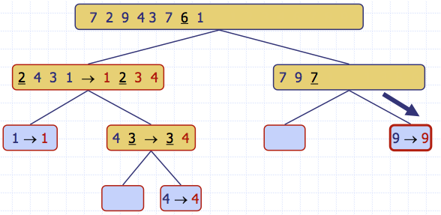
Execution Example (cont.)
Partition, …, recursive call, base case

Slide 67
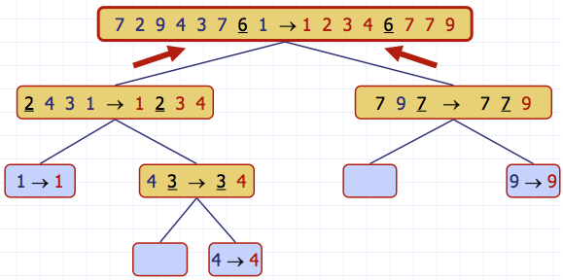
Execution Example (cont.)
Join, join

Slide 68
Quick-Sort Properties
The algorithm just described is stable, since elements are removed from the beginning of the input sequence and placed on the end of the output sequences (L,E, G).
However it does not sort in place: O(n) new memory is allocated for L, E and G
Is there an in-place quick-sort?

Slide 69
In-Place Quick-Sort
Note: Use the lecture slides here instead of the textbook implementation (Section 11.2.2)
Partition set into two using randomly chosen pivot
88
52
14
31
98
25
30
62
23
79
14
88
98
31
30
≤ 52 <
62
25
23
79

Slide 70
In-Place Quick-Sort
14
88
98
31
30
≤ 52 <
62
25
23
79
Get one friend to sort the first half.
Get one friend to sort the second half.
14,23,25,30,31
62,79,98,88

Slide 71
In-Place Quick-Sort
14,23,25,30,31
52
62,79,98,88
Glue pieces together.
(No real work)
14,23,25,30,31,52,62,79,88,98

Slide 72
The In-Place Partitioning Problem
Input:
Output:
x=52
88
52
14
88
14
98
31
98
31
30
≤ 52 <
62
25
30
25
23
79
62
23
79
Problem: Partition a list into a set of small values and a set of large values.

Slide 73
Precise Specification
p
r
p
q
r

Slide 74
Loop Invariant
3 subsets are maintained
One containing values less than or equal to the pivot
One containing values greater than the pivot
One containing values yet to be processed

Slide 75
Maintaining Loop Invariant
Consider element at location j
If greater than pivot, incorporate into ‘> set’ by incrementing j.
If less than or equal to pivot, incorporate into ‘≤ set’ by swapping with element at location i+1 and incrementing both i and j.
Measure of progress: size of unprocessed set.

Slide 76
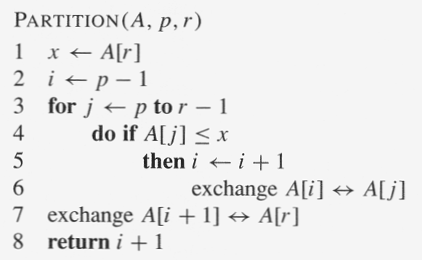
Maintaining Loop Invariant

Slide 77
Establishing Loop Invariant

Slide 78
Establishing Postcondition
Exhaustive on exit

Slide 79
Establishing Postcondition

Slide 80
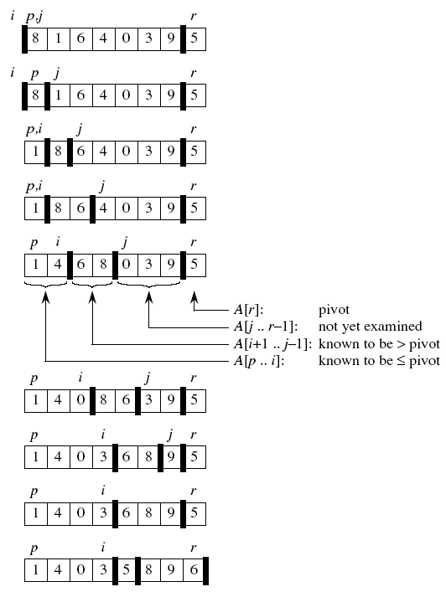
An Example

Slide 81
In-Place Partitioning: Running Time
Each iteration takes O(1) time →Total = O(n)
or

Slide 82
In-Place Partitioning is NOT Stable
or

Slide 83
The In-Place Quick-Sort Algorithm
Algorithm QuickSort(A, p, r)
if p < r
q = Partition(A, p, r)
QuickSort(A, p, q - 1) //Small elements are sorted
QuickSort(A, q + 1, r) //Large elements are sorted
//Thus input is sorted

Slide 84
Running Time of Quick-Sort

Slide 85
Quick-Sort Running Time
We can analyze the running time of Quick-Sort using a recursion tree.
At depth i of the tree, the problem is partitioned into 2^{i} sub-problems.
The running time will be determined by how balanced these partitions are.
depth
0
1
…
h
…

Slide 86
Quick Sort
Let pivot be the first element in the list?
88
52
14
31
98
25
30
62
23
79
14
88
98
30
≤ 31 ≤
62
25
23
52
79

Slide 87
Quick Sort
14,23,25,30,31,52,62,79,88,98
≤ 14 <
23,25,30,31,52,62,79,88,98
If the list is already sorted, then the list is worst case unbalanced.

Slide 88
QuickSort: Choosing the Pivot
Common choices are:
random element
middle element
median of first, middle and last element

Slide 89
Best-Case Running Time
The best case for quick-sort occurs when each pivot partitions the array in half.
Then there are O(log n) levels
There is O(n) work at each level
Thus total running time is O(n log n)
depth | time
0 | n
1 | n
… | …
i | n
… | …
log n | n

Slide 90
Quick Sort
Best Time:
T(n) = 2T(n/2) + Θ(n) = Θ(n log n)
Worst Time:
Expected Time:

Slide 91
Worst-case Running Time
The worst case for quick-sort occurs when the pivot is the unique minimum or maximum element
One of L and G has size n − 1 and the other has size 0
The running time is proportional to the sum
n + (n − 1) + … + 2 + 1
Thus, the worst-case running time of quick-sort is O(n²)
depth | time
0 | n
1 | n − 1
… | …
n − 1 | 1
…

Slide 92
Average-Case Running Time
If the pivot is selected randomly, the average-case running time for Quick Sort is O(n log n).
Proving this requires a probabilistic analysis.
We will simply provide an intution for why average-case O(n log n) is reasonable.
depth
0
1
…
h
…

Slide 93
Expected Time Complexity for Quick Sort

Slide 94
Expected Time Complexity for Quick Sort

Slide 95
Properties of QuickSort
In-place?
Stable?
Fast?
Depends.
Worst Case:
Expected Case:
✓
But not both!
✓

Slide 96
Summary of Comparison Sorts
Algorithm | Best Case | Worst Case | Average Case | In Place | Stable | Comments
Selection | n² | n² |  | Yes | Yes
Bubble | n | n² |  | Yes | Yes | Must count swaps for linear best case running time.
Insertion | n | n² |  | Yes | Yes | Good if often almost sorted
Merge | n log n | n log n |  | No | Yes | Good for very large datasets that require swapping to disk
Heap | n log n | n log n |  | Yes | No | Best if guaranteed n log n required
Quick | n log n | n² | n log n | Yes | Yes | Usually fastest in practice
But not both!

Slide 97
Outline
Definitions
Comparison Sorting Algorithms
Selection Sort
Bubble Sort
Insertion Sort
Merge Sort
Heap Sort
Quick Sort
Lower Bound on Comparison Sorts

Slide 98
Comparison Sort: Lower Bound
Can we do better?

Slide 99
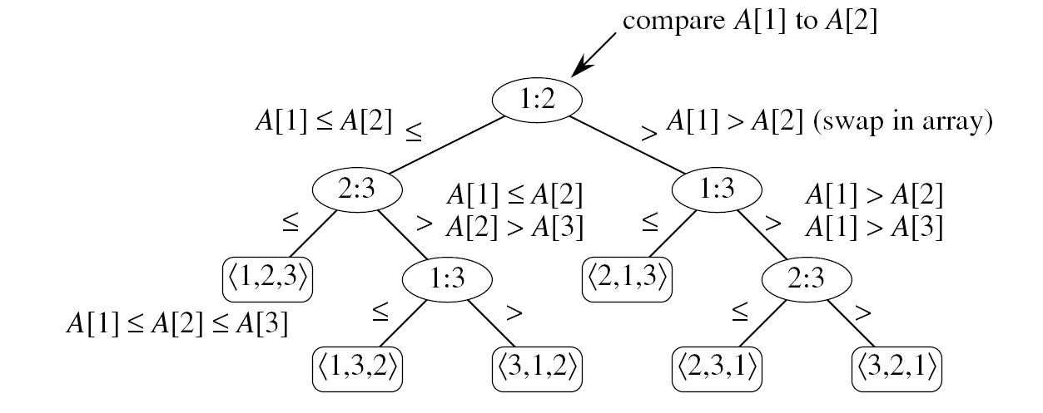
Comparison Sort: Decision Trees
Example: Sorting a 3-element array A[1..3]

Slide 100
Comparison Sort: Decision Trees
For a 3-element array, there are 6 external nodes.
For an n-element array, there are external nodes.

Slide 101
Comparison Sort
To store n! external nodes, a decision tree must have a height of at least
Worst-case time is equal to the height of the binary decision tree.
Thus MergeSort & HeapSort are asymptotically optimal.

Slide 102
Outline
Definitions
Comparison Sorting Algorithms
Selection Sort
Bubble Sort
Insertion Sort
Merge Sort
Heap Sort
Quick Sort
Lower Bound on Comparison Sorts

Slide 103
Comparison Sorts: Learning Outcomes
You should be able to:
Select a comparison sorting method that is well-suited for a specific application.
Explain what is meant by sorting in place and stable sorting
State a tight bound on the problem of comparison sorting, and explain why no algorithm can do better.
Explain and/or code any of the sorting algorithms we have covered, and state their asymptotic run times.

